Slide 1
TECH CHAMPION Programs and Trainers profiles
Corporate 02/07/20.

Slide 2
Programs
Design Thinking – Mentoring & Coaching

Slide 3
Ahmed Salama Director, Enterprise Digital Solution Devoteam
Design Thinking – Business Models
SAMPLE FOR TECH CHAMPION
Speaker/s:
Program:
Mentoring / Coaching
Offline in Riyadh / Online
1 hour a week (Total 12 hours)
Subject:
Many organizations are being measured based on their ability to provide quality services to their beneficiaries whether they are citizens, residents, customers or employees.
Abstract:
How can you build a framework to govern the way you are managing your services?
What are the key pillars of having innovative service management in an organization? What tools can be used to ensure that such services are being delivered as per the different KPI's and strategic objectives?
Audience:
Any induvial or group participant facing difficulties in ….

Slide 4
Trainers Profile
Ahmad Salama

Slide 5
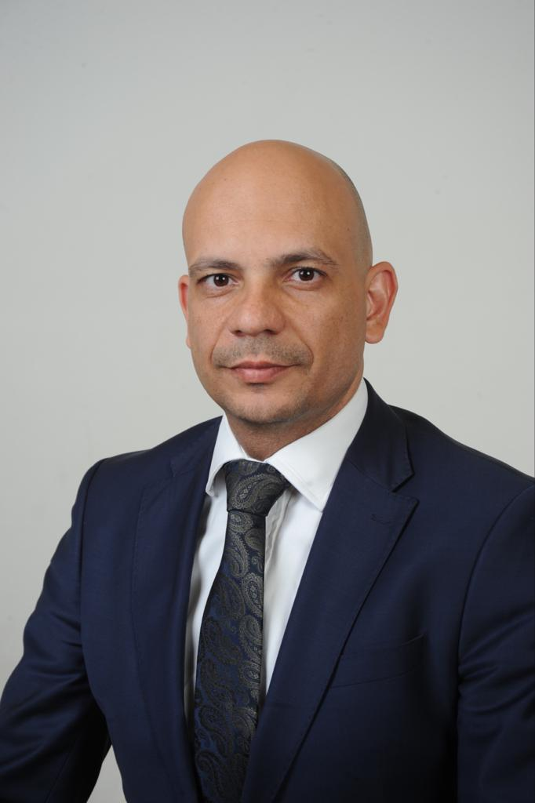


Key Expertise:
Digital Transformation
IT Service Management
IT Governance
AI
Business Continuity
Profile for publishing:
Ahmed Salama
Director, Enterprise Digital Solution Devoteam
Emad is director at devoteam Middle East, with an excellent and demonstrated history of working in the IT consulting and services delivery, presales, sales, business development and operations management. Credited with M.Sc. degree, Project Management Professional, International Supply Chain Manager, ITIL Certification, multiple certification in leading enterprise solutions such as ServiceNow, Oracle and SAP with 20+ years of experience.
Extensive experience in setting up new business units and developing an executable and successful GTM strategy that brought tangible results and increased the business value and volume.
Expertise: Enterprise applications and platforms, AI, IT Strategy, Business Consulting
Projects:
National Housing Company Enterprise support, Ministry of Education Enterprise support platform project and multiple national wide project in the Middle East.
Publications: Forbes: The Next stage of AI implementation for business Link
Awards: Multiple technology partners Awards
Speaker @ Forbes Digital Trends Middle East
Ahmedsalama@devoteam.com
LinkedIn: Devoteam
https://www.linkedin.com/company/devoteam
Twitter: @DevoteamMideast
Key Projects & Achievements
Leading IT Service Management & Business Continuity Projects
National Housing Company Enterprise support
Ministry of Education Enterprise support platform project
Established and grew the Services Business in Fujitsu Middle East
Led multiple national wide projects in KSA, UAE and the Middle East
Introduced new functions and pillars into services delivery business units
Previous Experience
ITSM Consultant, Nassej, Saudi Arbaia 2009 - 2015
IT Manager & Consultant, Horizons, Egypt 2003-2009
System Admin & Network Engineer 2000-2003
Main Professional skills
Design Thinker, Story Teller and Creativity Enabler
Building strategic relations
Digital Visionary and Advocate
Training & Certification
ITIL 4 Managing Professional
ITIL V3 Expert
Project Management Professional
TOGAF 9 Certified
Certified Governance for IT
ISO20000 Lead Implementer and Auditor
ISO22301 Lead Implementer
Design Thinking Advanced Certificate
DevOps Foundation
IT4IT Foundation
COBIT 5 Foundation
Ahmed Salama
Lead Consultant, Strategy & Transformation Devoteam
Emad is director at devoteam Middle East, with an excellent and demonstrated history of working in the IT consulting and services delivery, presales, sales, business development and operations management. Credited with M.Sc. degree, Project Management Professional, International Supply Chain Manager, ITIL Certified, many other certifications from leading enterprise solutions such as ServiceNow, Oracle, and SAP with 20+ years of experience.
Extensive experience in setting up new business units and developing an executable and successful GTM strategy that brought tangible results and increased the business value and volume
+20 Years of Experience

